Slide 1
Java virtual machine (jvm)
Author : Parag paralikar

Slide 2
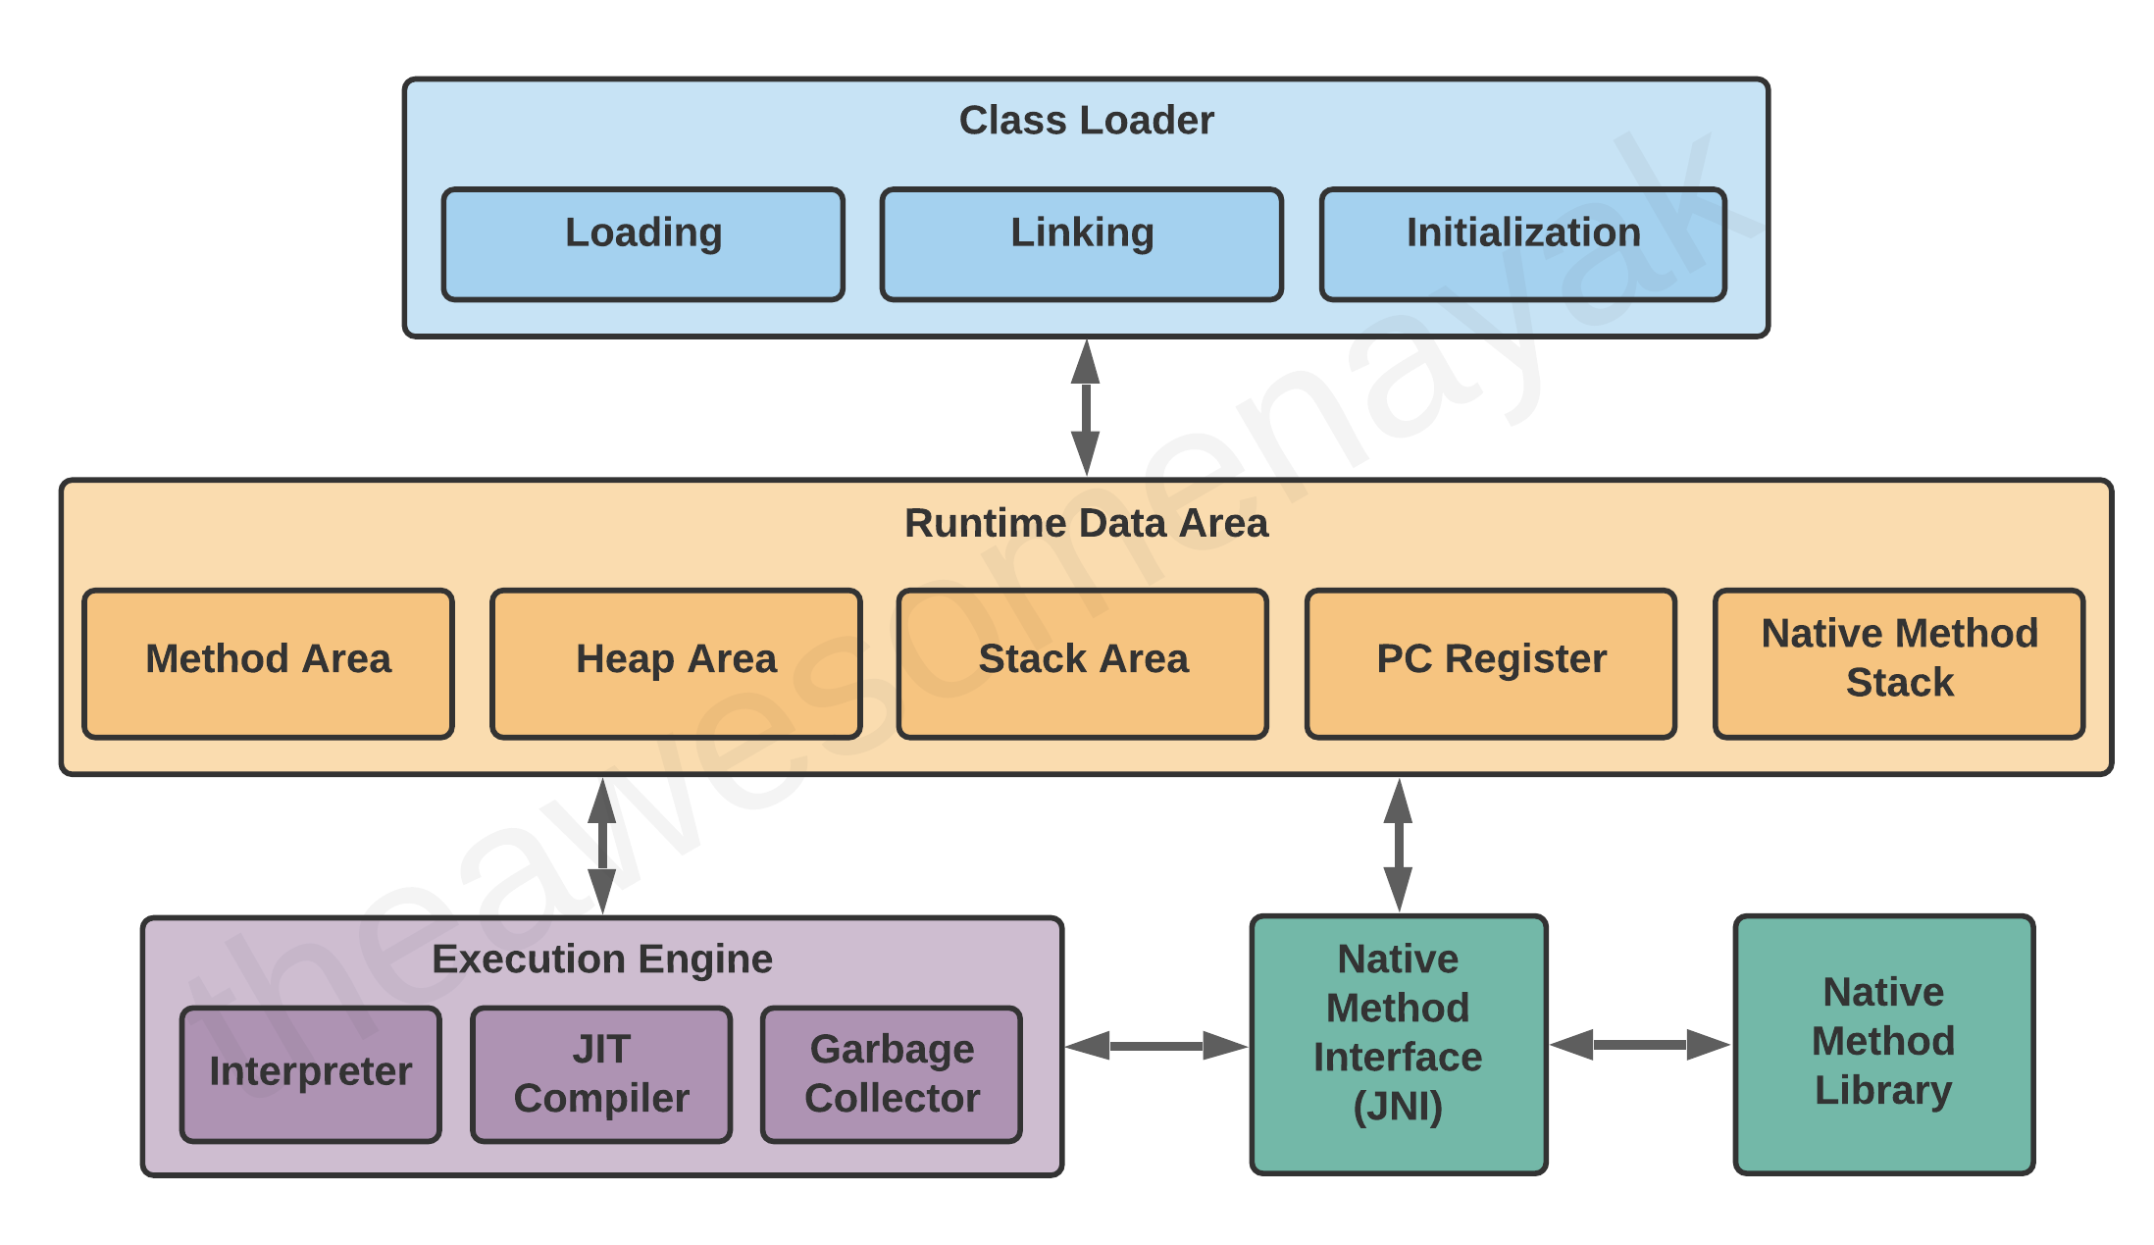
Jvm architecture

Slide 3
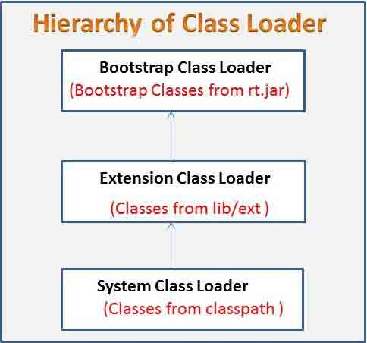
Class loader Hierarchy

Slide 4
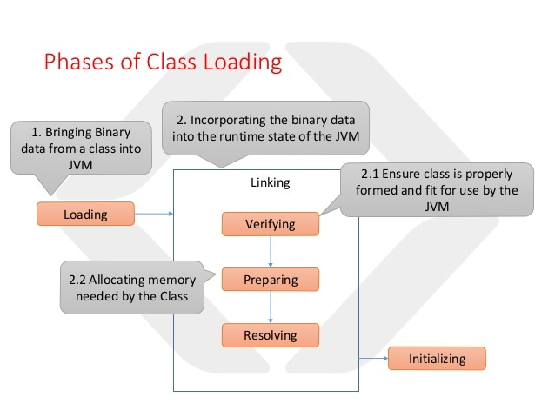
Class loading process

Slide 5
Class loading types
Static – Using new operator, throws NoClassDefFoundError at compile time
Dynamic – Using Class.forName, ClassLoader.loadClass, or findSystemClass, throws ClassNotFoundException at runtime

Slide 6
Class loader principles
DELEGATION – Delegate all requests to parent classloader, if not found, then only load it
VISIBILITY – Child classloader can see all the classes loaded by parent classloder, not vice versa
UNIQUENESS – One class is loaded only once, this is achieved by delegation

Slide 7
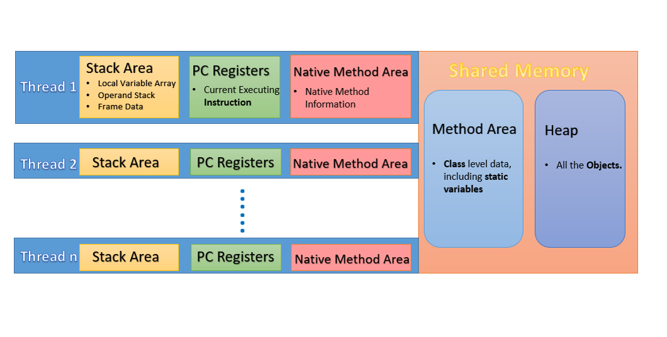
Memory management

Slide 8
Java execution engine
INTERPRETER – Interprets the class byte code line by line
JUST IN TIME (JIT) COMPILER - Increases efficiency of interpreter, provides direct native code for repetitive method calls
GARBASE COLLECTOR – Removes unreachable objects from memory

Slide 9
Garbage collection
Process of automatic memory management by reclaiming the runtime unused memory by unreachable objects.
Provides opportunity for clean up to objects being collected through Object.finalize() method
This process starts from GC roots.
Local variables
Static variables
Alive threads
JNI variables

Slide 10
Types of references
STRONG – Not eligible for garbage collection. At the time of creating new object, if all of heap is filled with strong references, then OutOfMemoryError will be thrown.
SOFT – Collected only when JVM absolutely needs memory, hence these are suitable for caches.
PHANTOM – Dev can control gc eligibility of objects by keeping them in a ReferenceQueue. These will not be collected until they are removed from the queue.
WEAK – These are eagerly garbage collected. These are used in third party libraries and frameworks where author is agnostic of object lifecycle in application.

Slide 11
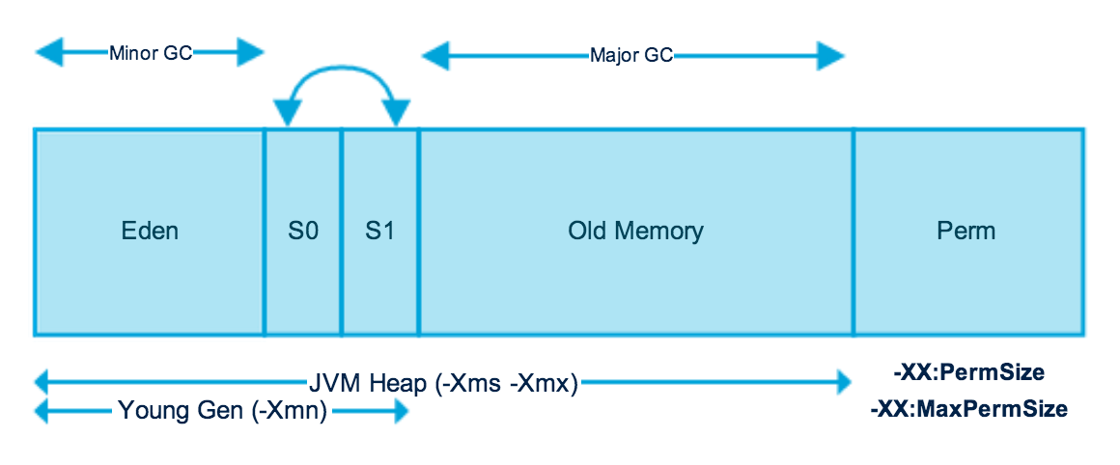
PROCESS OF GARBAGE COLLECTION

Slide 12
types of Garbage collection
MINOR GC
Triggered frequently.
Stop the word event
Happens only in Eden and Survivor spaces ie Young generation.
MAJOR GC
Happens in Tenured space
FULL GC
Collects garbage from all of heap
Triggered less frequently
Triggered rarely

Slide 13
Types of garbage collectors
SERIAL – XX:+UseSerialGC : Uses single thread for young and old generation
PARALLEL – XX:+UseParallelGC : Uses one thread per CPU core for young and single thread for old generation
PARALLEL OLD – XX:+UseParallelOldGC : Uses one thread per CPU core for young and old generation
CONCURRENT MARK AND SWEEP (CMS) – XX:+UseConcMarkSweepGC : Runs in parallel with application threads
GARBAGE FIRST (G1) – XX:+UseG1GC : Divide heap in segments to process

